Slide 1

CURVE FITTING
DAVID COOPER
SUMMER 2014

Slide 2
Basics of Fitting
Curve Fitting is one of the most useful analytical techniques that you can apply to a set of data
MATLAB has built in feature with the Curve fitting toolbox that we will be focusing on
Fitting optimizes the parameters in a given model to help best match the values in some observable
Technically fitting applies to a number of methods which generate an approximate model function but we will be focusing on Regression analysis

Slide 3
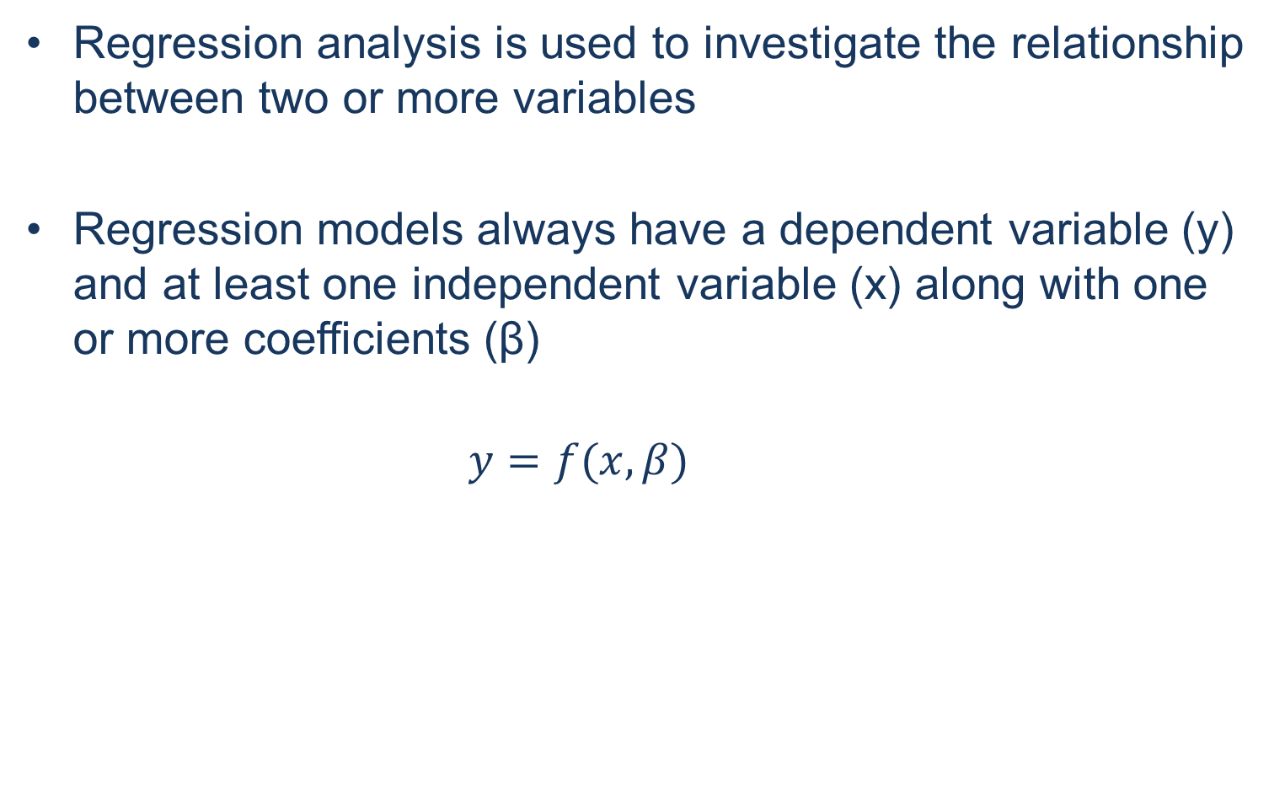
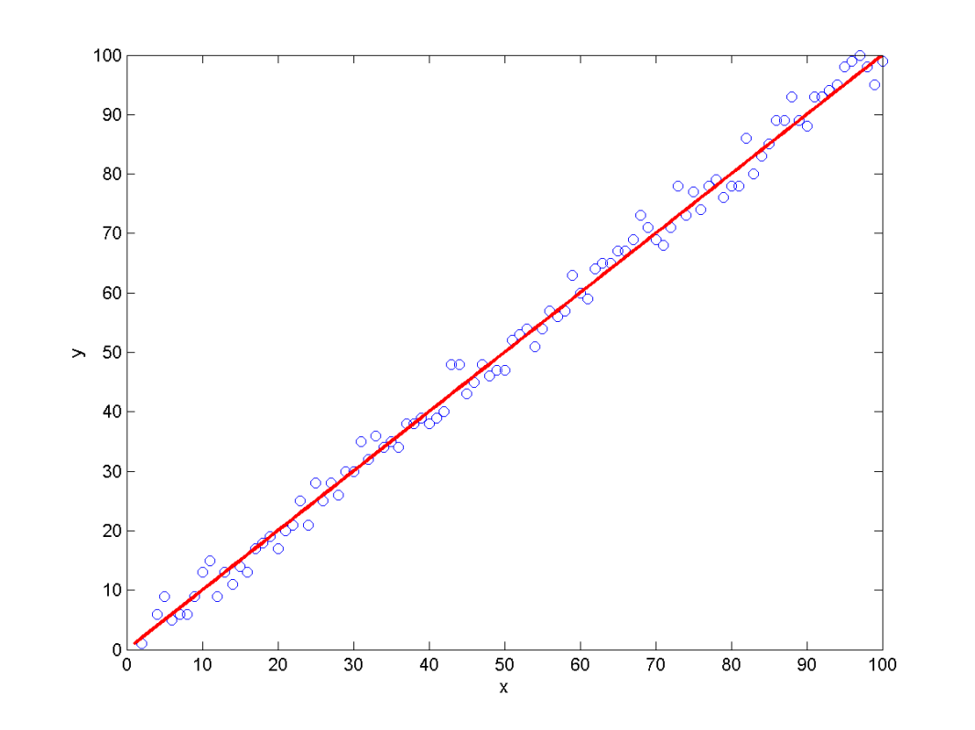
Regression analysis

Slide 4
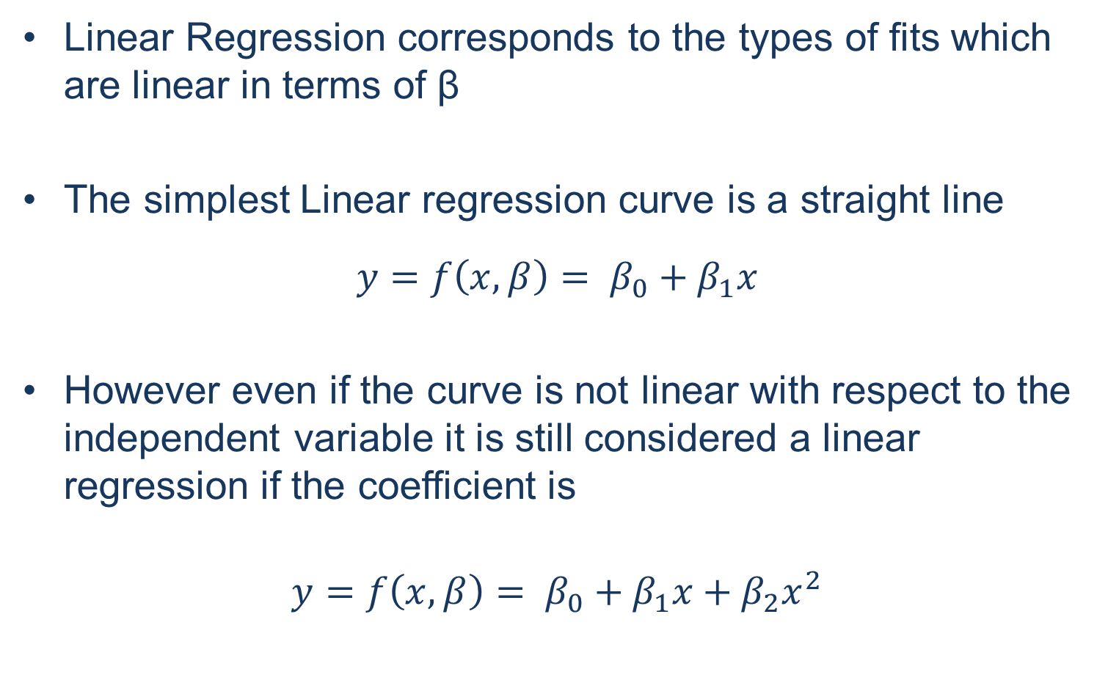
Linear Regression

Slide 5
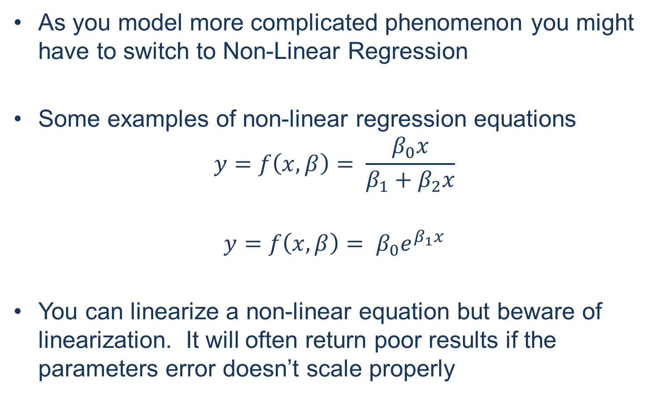
Non-Linear Regression

Slide 6
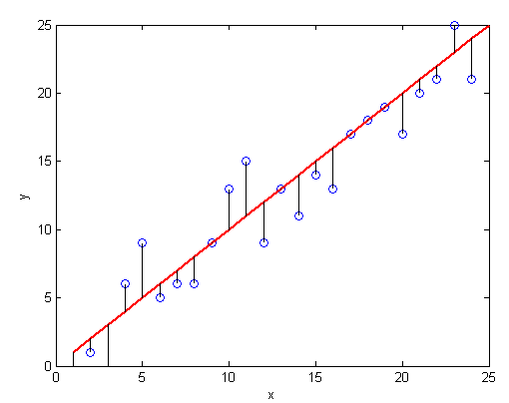
Residuals
Residuals refer to the deviation between the model curve and the data.
Residuals are important as they
are the property that you are
evaluating
Residuals are sometimes referred to as the error, however for our purposes we will use error only to refer to the inaccuracies in the data itself .

Slide 7
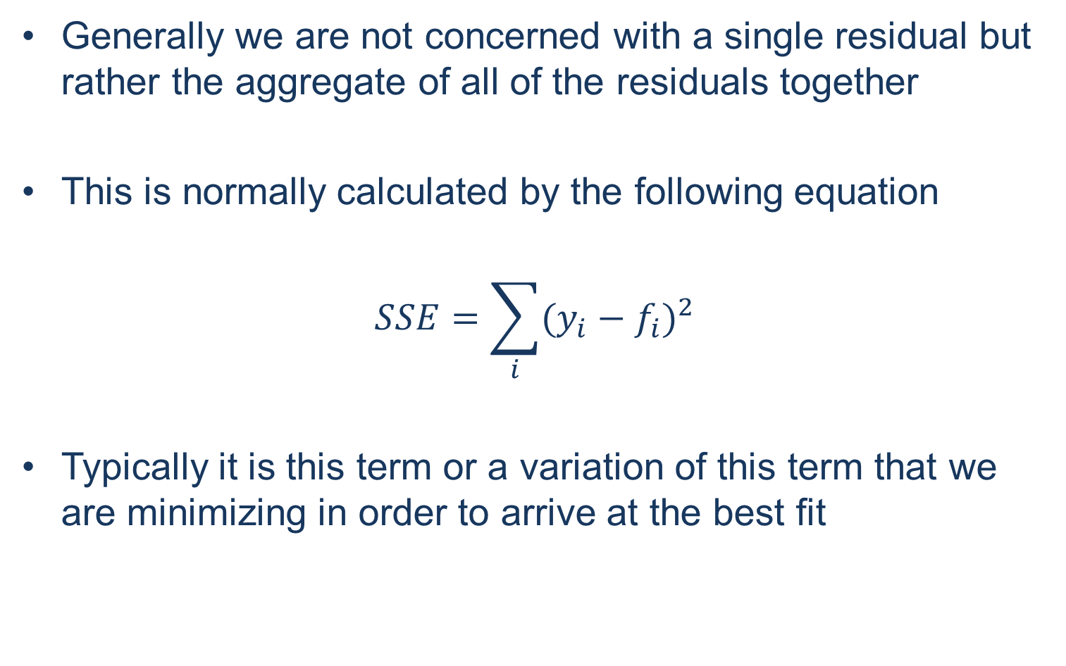
Sum of Squared Residuals

Slide 8
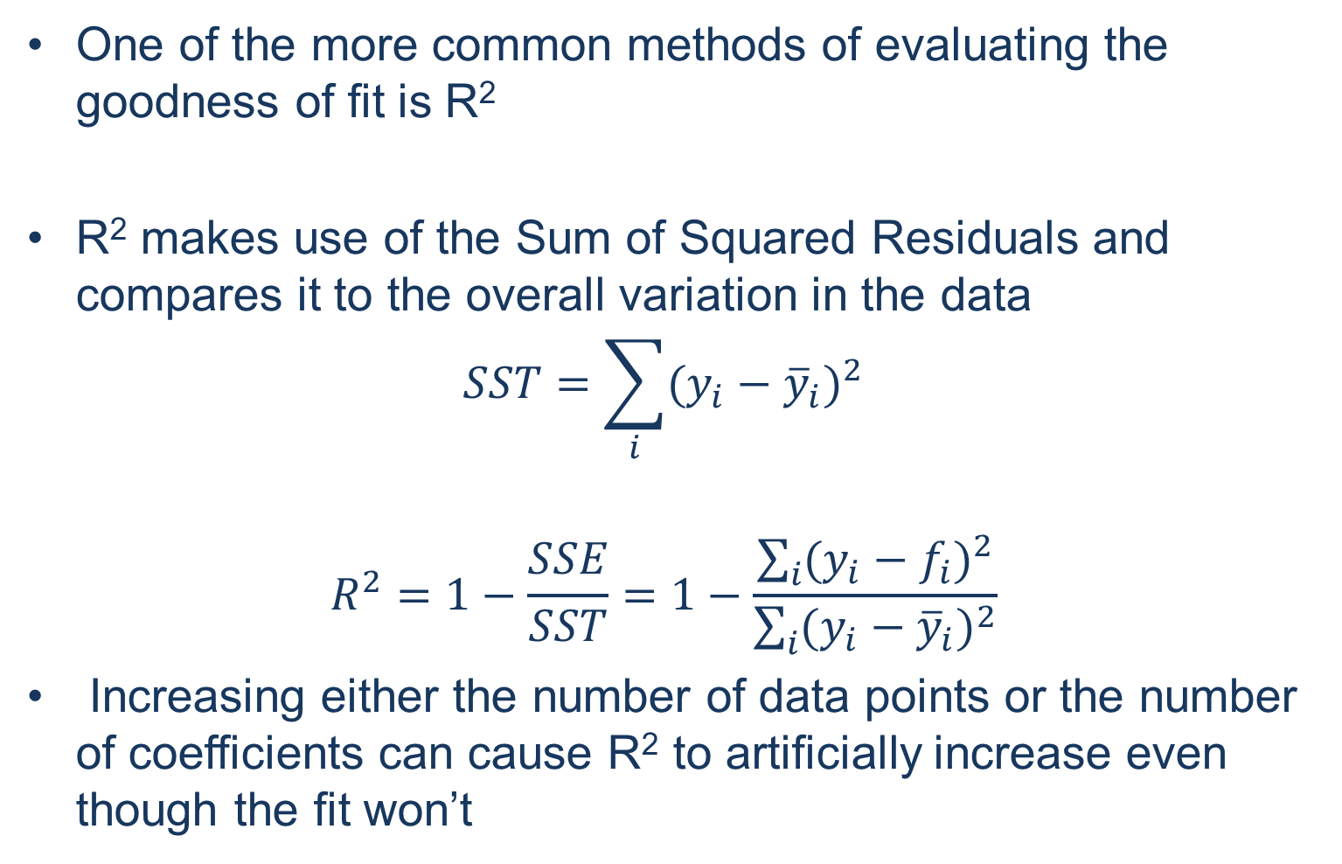
R²

Slide 9
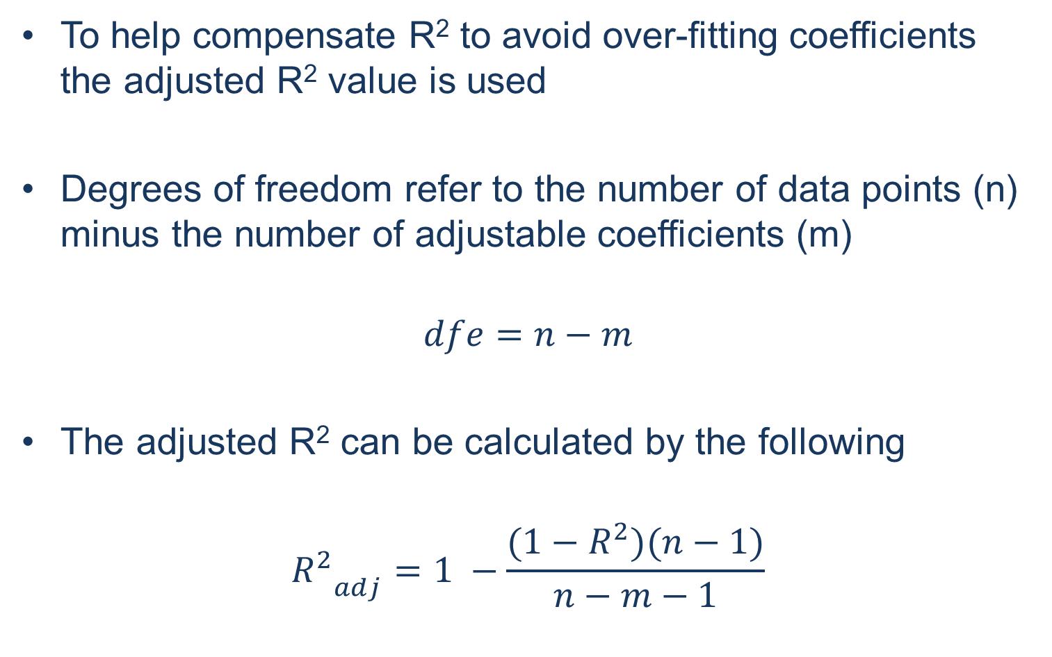
Degrees of Freedom and Adjusted R²

Slide 10
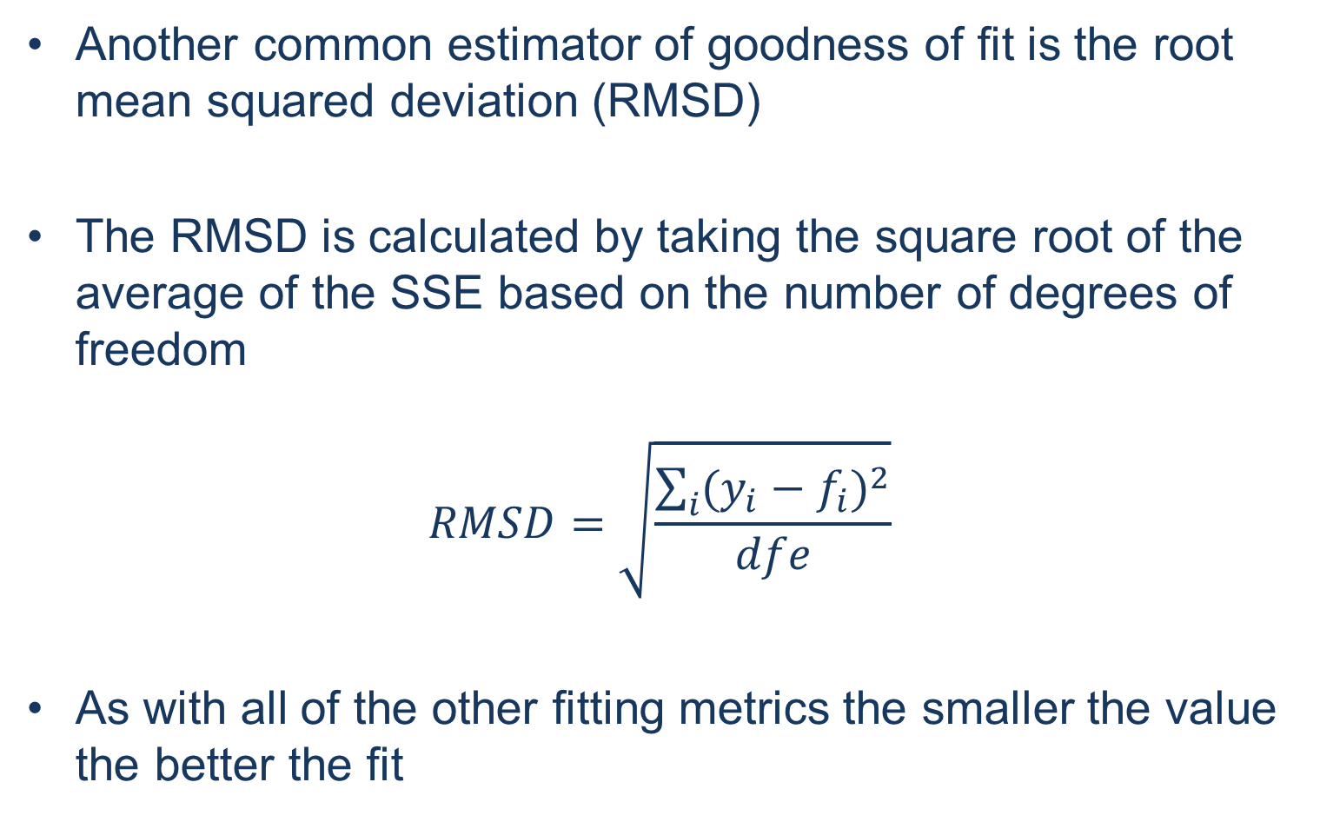
Alternative Fitting Metrics

Slide 11
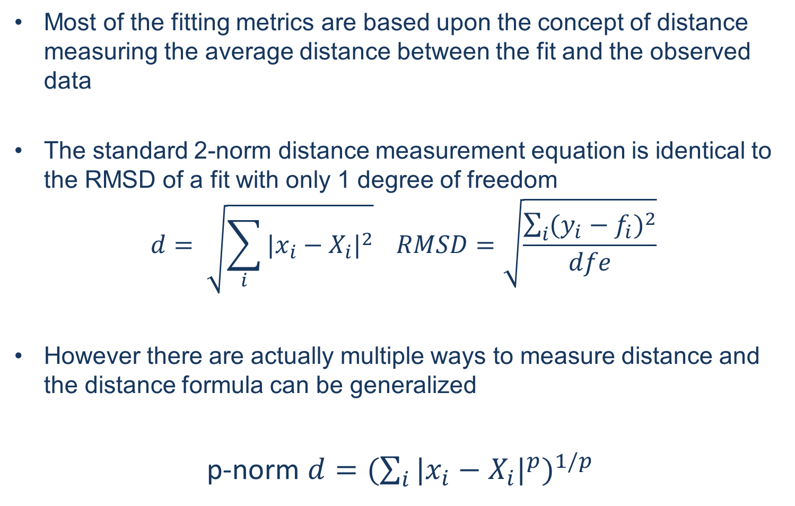
Distance

Slide 12


Distance
(x₁,y₁)
(x₂,y₂)
Changing the norm affects the sensitivity of the distance measurement to the elements. The most common use of alternate norm is the 1 norm
The 1 norm minimizes the impact that outliers have on a fit and can be useful if you want to ignore single outlier cases

Slide 13
Creating a Fit Function
The easiest way to create a new custom fit is to use the fit function from the curve fitting toolbox
  >> [fitobj gof] = fit(x, y, fittype)
Note that for fit x and y MUST be columns
fitobj is a fit object that can be used for plotting your fit or extracting the coefficients
  >> coef = coeffvalues(fitobj)
gof is a structure that contains the various goodness of fit metrics precalculated
The parameter fittype tells fit what function to fit the data to. There are a handful of premade fit types such as the basic 1 and 2 term polynomials

Slide 14
Custom Fit Types
More often than not you will want to create your own fitting function with fittype()
  >> myFitType = fittype(‘model’)
The model function needs to be a string that is your desired fit function. It can be either Linear or Non-Linear and contain function calls
All desired fit coefficients and fit variables should be names but otherwise it needs to be entered with standard MATLAB syntax as if the variables were vectors and the coefficients were scalars
All coefficients and variables should be defined in the fittype call. Additionally if there are multiple coefficients they need to be in a cell object wrapped with { }
  >> myFitType = fittype(‘a*x.*cos(b*x)’ , ‘coefficients’, {‘a’ , ‘b’} , ‘independent’ , ‘x’)

Slide 15
Fitting Options
Fitting options can be included as their own variable called with fitoptions() or they can be included with either the fittype() or the fit() function
Fit options contain useful parameters for the fit such as ‘Upper’ and ‘Lower’ which define the upper and lower bounds of the coefficients
Other common fit options define the starting point for all of the coefficients (‘StartPoint’) as well as options to limit how long MATLAB will work on the fit (‘MaxFunEvals’) and (‘MaxIter’)

Slide 16
Creating the fit without CFT
You can also create your own fitting function using fminsearch()
  >> coef = fminsearch(@fun, coefStart, optsions)
This allows for both specification of the fitting function as well as the residual that you will be minimizing
To specify the fit function you need to create a new function inside of the custom fit function that takes in the starting position and returns the residual value that you are monitoring. This nested function contains all of the important information.
In the case for which you have multiple coefficients make sure that they are all in a single vector
NOTE: This method works best as an optimization of fit() to ensure that you are at a local minimum for the residual

Slide 17
Creating the fit without CFT
The overall function will look something like this
  function coefout = myFit(x,y)
  coeffs = [1 1];
  coefout = fminsearch(@myFunRMSD,coeffs);
  function RMSD = myFunRMSD(coeffs)
  fx = (coeffs(1)*x) .* cos( coeffs(2)*x);
  resi = fx – y;
  sse = sum(resi.^2);
  dfe = numel(x) – numel(coeffs);
  RMSD = sqrt(sse/dfe)
  end
  end

